Slide 1
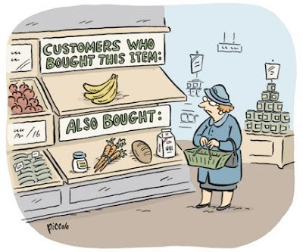
K-MEANS CLUSTERING

Slide 2
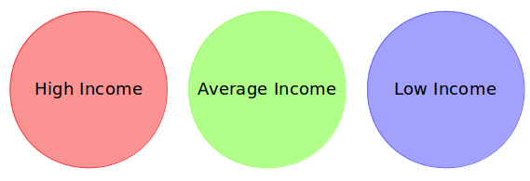
What is CLUSTERING?
Let’s understand this by an example:
A bank wants to give credit card offers to its customers. Currently, they look at the details of each customer and based on this information, decide which offer should be given to which customer.
Now, the bank can potentially have millions of customers. Does it make sense to look at the details of each customer separately and then make a decision? Certainly not! It is a manual process and will take a huge amount of time.
So what can the bank do? One option is to segment its customers into different groups. For instance, the bank can group the customers based on their income:
The bank can now make three different strategies or offers, one for each group.
Here, instead of creating different strategies for individual customers, they only have to make 3 strategies.
This will reduce the effort as well as the time.

Slide 3
So how can CLUSTERING now be defined:
Clustering is the process of
dividing the entire data into groups
(also known as CLUSTERS)
based on the patterns in the data.

Slide 4
Is Clustering supervised or unsupervised?
Such problems, without any fixed target variable, are known as unsupervised learning problems.
In these problems, we only have the independent variables and no target/dependent variable.
In clustering, we do not have a target to predict. We look at the data and then try to club similar observations and form different groups. Hence it is an Unsupervised Learning Problem.

Slide 5
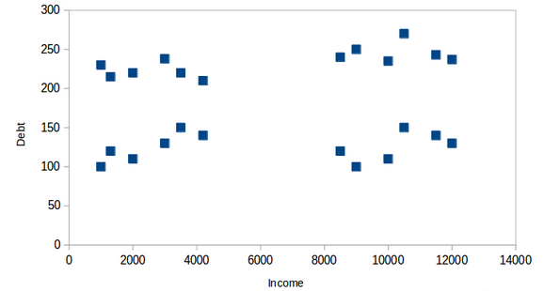
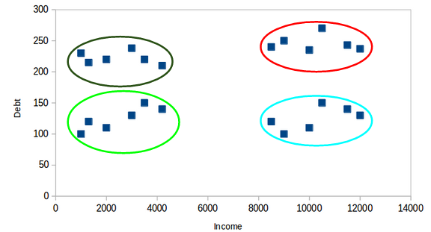
Properties of Clusters
Let’s start visualizing the following image:
On the X-axis, we have the income of the customer and the y-axis represents the amount of debt. Here, we can clearly visualize that these customers can be segmented into 4 different clusters as shown aside.
This is how clustering helps to create segments (clusters) from the data. The bank can further use these clusters to make strategies and offer discounts to its customers. So let’s look at the properties of these clusters.

Slide 6

Properties of Clustering:
Property 1: All the data points in a cluster should be similar to each other.
If the customers in a particular cluster are not similar to each other, then their requirements might vary, and If the bank gives them the same offer, they might not like it and their interest in the bank might reduce. Not ideal.
Having similar data points within the same cluster helps the bank to use targeted marketing. You can think of similar examples from your everyday life and think about how clustering will (or already does) impact the business strategy.

Slide 7
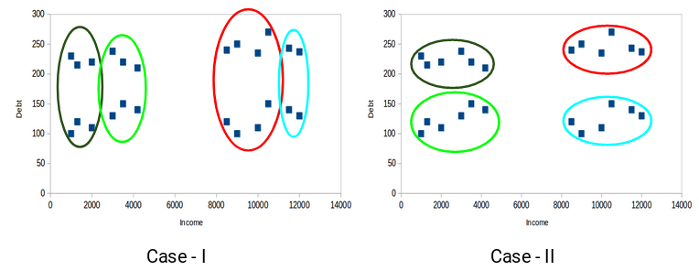
Property 2: The data points from different clusters should be as different as possible.
Which of these cases do you think will give us the better clusters? If you look at case I:
Customers in the red and blue clusters are quite similar to each other. The top four points in the red cluster share similar properties as that of the top two customers in the blue cluster. They have high income and high debt value.
Whereas, if you look at case II: Points in the red cluster are completely different from the customers in the blue cluster. All the customers in the red cluster have high income and high debt and customers in the blue cluster have high income and low debt value. Clearly we have a better clustering of customers in this case.
Hence, data points from different clusters should be as different from each other as possible to have more meaningful clusters.

Slide 8
Evaluation Metrics for Clustering
The primary aim of clustering is not just to make clusters, but to make good and meaningful ones. We saw this in the below example:
Here, we used only two features and hence it was easy for us to visualize and decide which of these clusters is better.
Unfortunately, that’s not how real-world scenarios work. We will have a ton of features to work with. Let’s take the customer segmentation example again – we will have features like customer’s income, occupation, gender, age, and many more.
Visualizing all these features together and deciding better and meaningful clusters would not be possible for us.
This is where we can make use of evaluation metrics. Let’s discuss a few of them and understand how we can use them to evaluate the quality of our clusters.

Slide 9
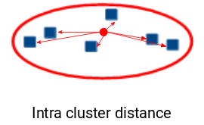
INERTIA:
Recall the first property of clusters we covered above. This is what inertia evaluates. It tells us how far the points within a cluster are.
Inertia actually calculates the sum of all the points within a cluster from the centroid of that cluster.
We calculate this for all the clusters and the final inertial value is the sum of all these distances. This distance within the clusters is known as Intra-Cluster Distance. So, inertia gives us the sum of Intra-cluster distances:
Is a small inertial value good or do we need a larger value? We want the points within the same cluster to be similar to each other, right?
Hence, The distance between them should be as low as possible.
we can say that The Lesser the inertia value, better the clusters are.

Slide 10
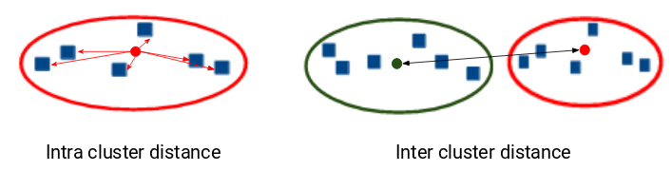
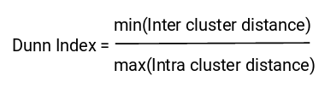
DUNN INDEX:
We now know that inertia tries to minimize the Intra-Cluster distance. It is trying to make more compact clusters.
So if the distance between the centroid of a cluster and the points in that cluster is small, it means that the points are closer to each other. So, inertia makes sure that the first property of clusters is satisfied.
But it does not care about the second property – that different clusters should be as different from each other as possible. This is where Dunn index can come into action.
Along with the distance between the centroid and points, the Dunn index also takes into account the distance between two clusters.
This distance between the centroids of two different clusters is known as inter-cluster distance.
Let’s look at the formula of the Dunn index:
Dunn index is the ratio of the minimum of Inter-cluster distances and maximum of Intra-cluster distances.

Slide 11
Introduction to K-Means Clustering
The main objective of the K-Means algorithm is to minimize the sum of distances between the points and their respective cluster centroid.
So, we can say K-means is a centroid-based algorithm, or a distance-based algorithm, where we calculate the distances to assign a point to a cluster. In K-Means, each cluster is associated with a centroid.

Slide 12
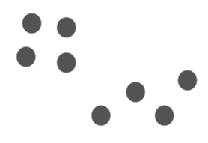
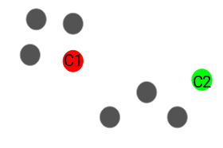
How does K-means works?
Let us understand by an example:
We have these 8 points and we want to apply k-means to create clusters for these points. Here’s how we can do it.
Step 1: Choose the number of clusters k
The first step in k-means is to pick the number of clusters, k.
Step 2: Select k random points from the data as centroids
Next, we randomly select the centroid for each cluster. Let’s say we want to have 2 clusters, so k is equal to 2 here. We then randomly select the centroid:
Here, the red and green circles represent the centroid for these clusters.

Slide 13
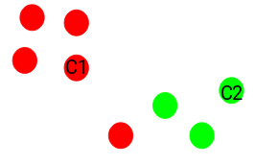
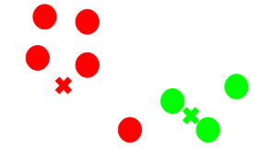
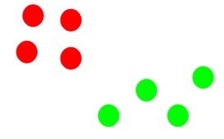
Cont.:
Step 3: Assign all the points to the closest cluster centroid
Once we have initialized the centroids, we assign each point to the closest cluster centroid:
Here you can see that the points which are closer to the red point are assigned to the red cluster whereas the points which are closer to the green point are assigned to the green cluster.
Step 4: Re-compute the centroids of newly formed clusters
Now, once we have assigned all of the points to either cluster, the next step is to compute the centroids of newly formed clusters:
Here, the red and green crosses are the new centroids.
Step 5: Repeat steps 3 and 4
We then repeat steps 3 and 4:
The step of computing the centroid and assigning all the points to the cluster based on their distance from the centroid is a single iteration.

Slide 14
Cont.:
Stopping Criteria for K-Means Clustering
There are essentially three stopping criteria that can be adopted to stop the K-means algorithm:
Centroids of newly formed clusters do not change
Points remain in the same cluster
Maximum number of iterations are reached
We can stop the algorithm if the centroids of newly formed clusters are not changing. Even after multiple iterations, if we are getting the same centroids for all the clusters, we can say that the algorithm is not learning any new pattern and it is a sign to stop the training.
Another clear sign that we should stop the training process if the points remain in the same cluster even after training the algorithm for multiple iterations.
Finally, we can stop the training if the maximum number of iterations is reached. Suppose if we have set the number of iterations as 100. The process will repeat for 100 iterations before stopping.

Slide 15
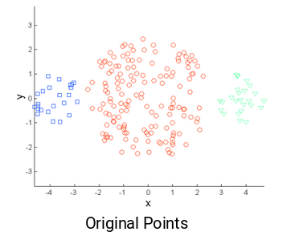
Challenges with the K-Means Clustering
One of the common challenges we face while working with K-Means is that the size of clusters is different. Let’s say we have the below points:

Slide 16
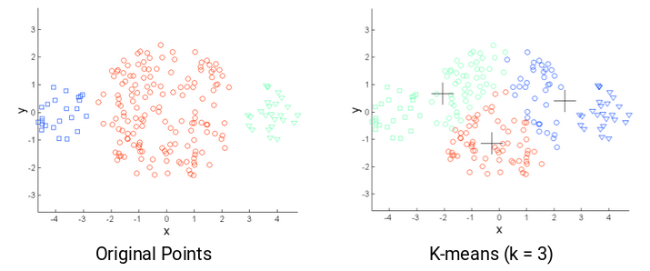
Cont.:
The left and the rightmost clusters are of smaller size compared to the central cluster. Now, if we apply k-means clustering on these points, the results will be something like this:

Slide 17
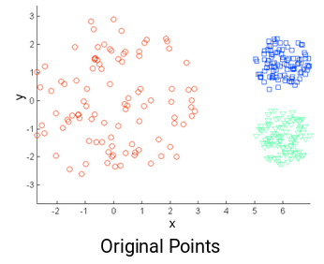
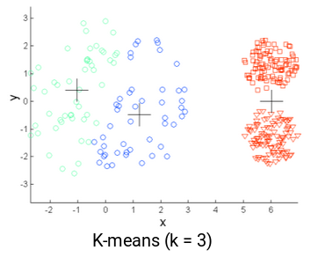
Cont.:
Another challenge with k-means is when the densities of the original points are different. Let’s say these are the original points:
One of the solutions is to use a higher number of clusters. So, in all the above scenarios, instead of using 3 clusters, we can have a bigger number. Perhaps setting k=10 might lead to more meaningful clusters.
Here, the points in the red cluster are spread out whereas the points in the remaining clusters are closely packed together. Now, if we apply k-means on these points, we will get clusters like this:
We can see that the compact points have been assigned to a single cluster. Whereas the points that are spread loosely but were in the same cluster, have been assigned to different clusters.

